Slide 1
Secure Provider Portal
Waiver Provider Quick Billing Guide
Secure Provider Portal Quick Billing Guide

Slide 2
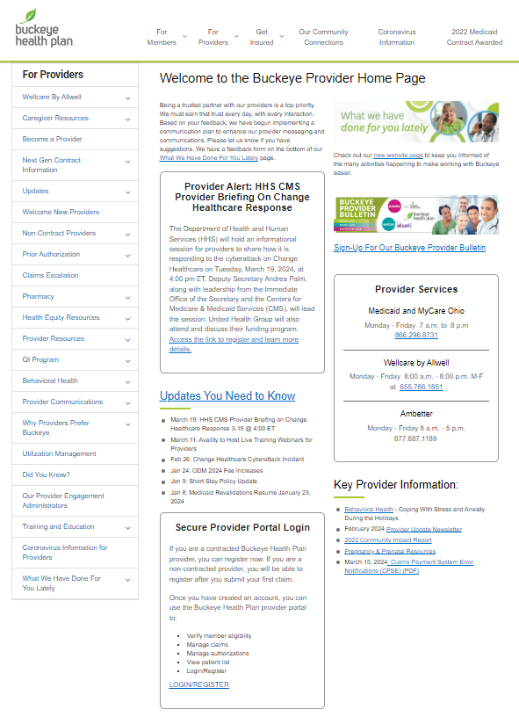
Provider Home Page
Navigate to the Provider Home Page to find the Portal Login.
If you don’t have it bookmarked, you can find it on our provider website pages at: https://www.buckeyehealthplan.com/providers.html

Slide 3
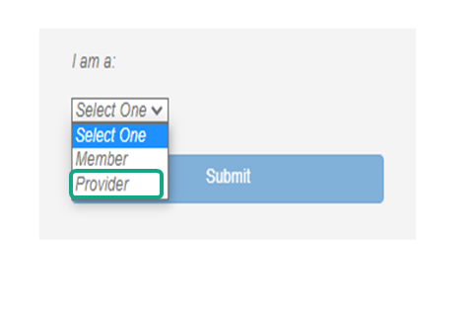
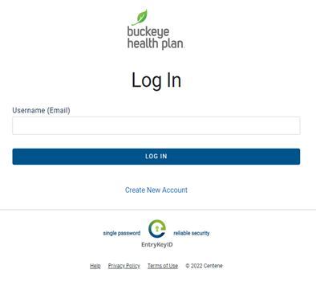
Provider Login
STEP 1: Log in to the secure portal.
BE PREPARED! — Your first entries will require member name, account number (MMIS), date of birth, provider tax ID (or social security), and billing and location/facility address(es).

Slide 4
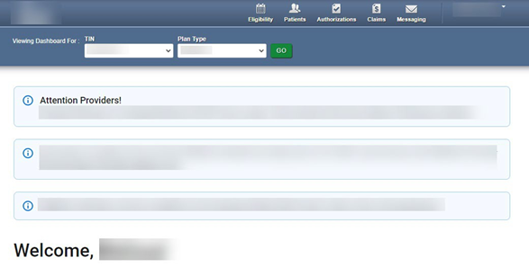

Provider Dashboard
STEP 2: Click the Claims icon on the dashboard header.
Dashboard features:
View Claims & Status
Check eligibility
View Patient List
Submit Claims
Send a Secure Message
Manage Accounts
Access Reports

Slide 5
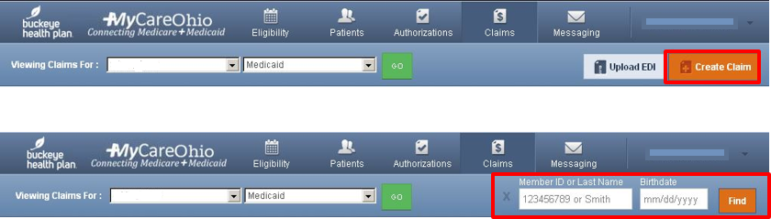
Create Claim
STEP 3: Click Create Claim.
STEP 4: Enter Member ID* or Last Name AND Date of Birth.
Click Find.
* Member ID is the member’s MMIS # or Medicaid ID # located on the member’s Buckeye ID card.

Slide 6
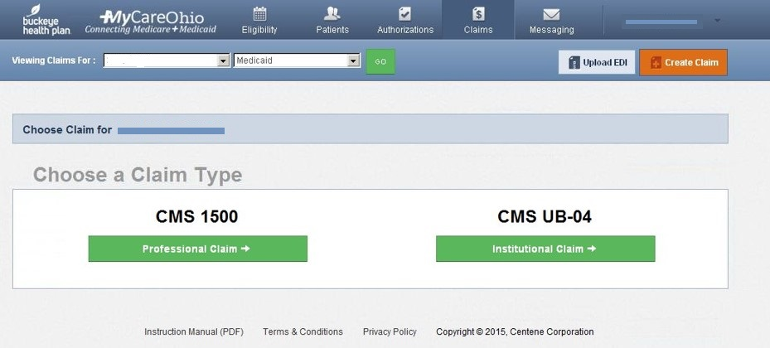
Claim Type
STEP 5: Choose a Claim Type*.
* Select CMS 1500 – Professional Claim for Waiver Services including Assisted Living and Out-of-home respite services.

Slide 7
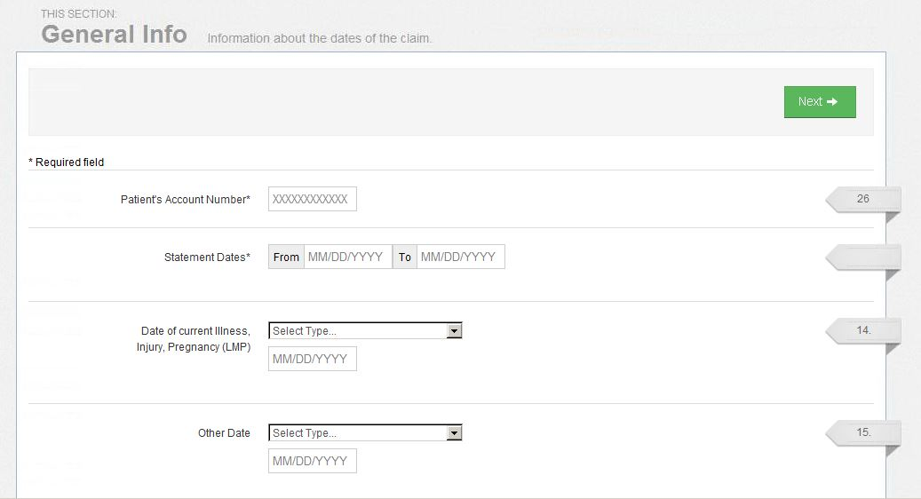
Statement Dates
STEP 6: Enter Patient’s Account Number (Member Medicaid ID or MMIS #).
STEP 7: Enter the “From” and “To” dates for the service billing period.
Click Next.
Required fields are marked with asterisks(*).

Slide 8
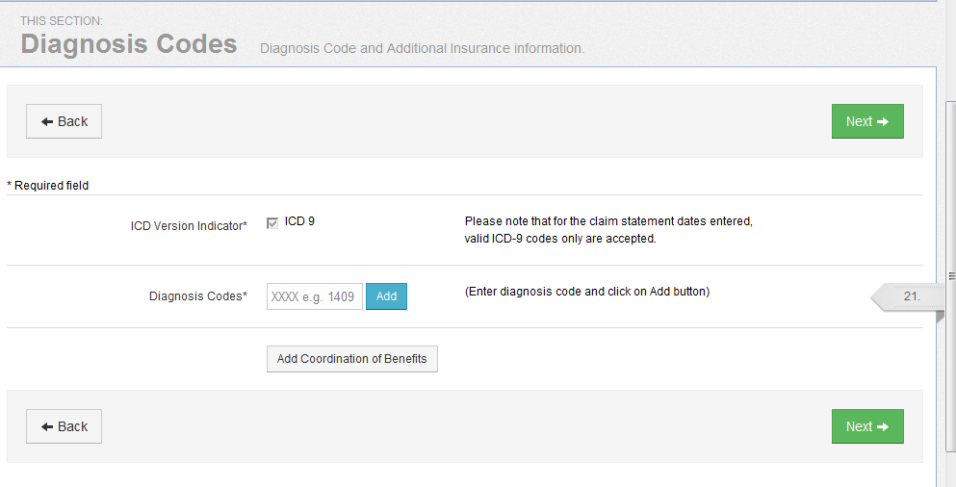
Diagnosis Codes
STEP 8: Enter diagnosis code and click on Add button.
Click Next.
Diagnosis code with description will populate below diagnosis field box after clicking “Add”.

Slide 9
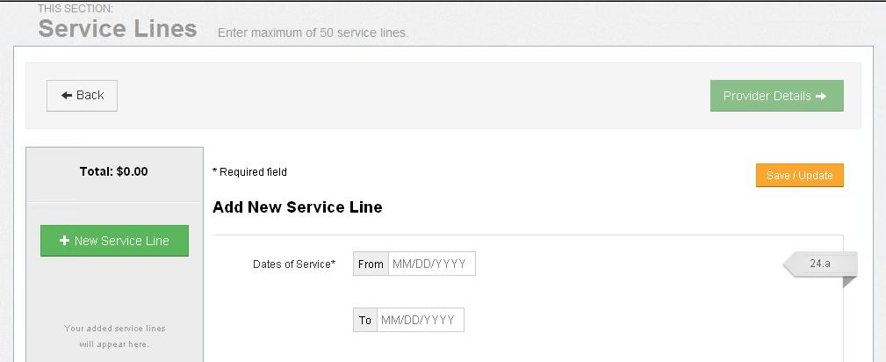
Service Lines
STEP 9: Enter Dates of Service*.
* Only ONE date of service per service line should be entered (i.e. “From” date and “To” date should be the SAME date). Dates of Service must fall within the Statement Dates entered in Step 7.
Assisted Living providers should use the Multiple Claims Submission option.

Slide 10
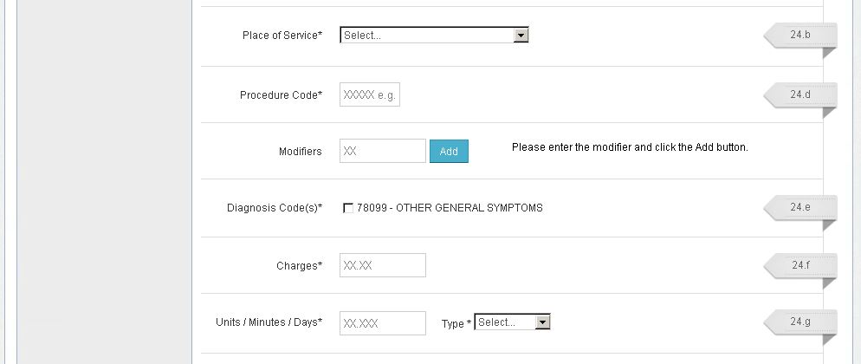
Service Lines (Cont’d)
STEP 10: Select Place of Service from the drop-down menu.
STEP 11: Enter Service Procedure Code.
STEP 12: Enter Modifier(s) where applicable and click the Add* button.
* IMPORTANT: You must click the Add button for the modifier(s) to be added to the claim service line. Missing claim modifier(s) where required may result in incorrect reimbursement and/or service line or claim denial.

Slide 11
Service Lines (Cont’d)
STEP 13: Check box(es) to confirm previously entered Diagnosis Code(s).
STEP 14: Enter total Charges*.
STEP 15: Enter total Units/Minutes/Days* and select Type from the drop-down menu.
* NOTE: You must pre-calculate the total Charges and total Units for the Date of Service and enter in the designated fields.

Slide 12
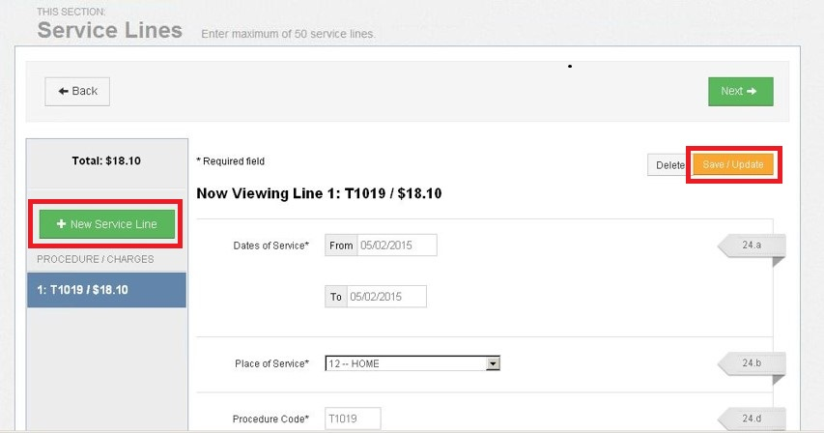
Service Lines (Cont’d)
STEP 16: Click Save/Update.
To add additional Service Lines*, scroll to the top and click + New Service Line.
Repeat Steps 9‐16 until all service line entries are completed.
Click Next.
* You will notice that each Service Line entry will show listed in the gray shaded column on the left.

Slide 13
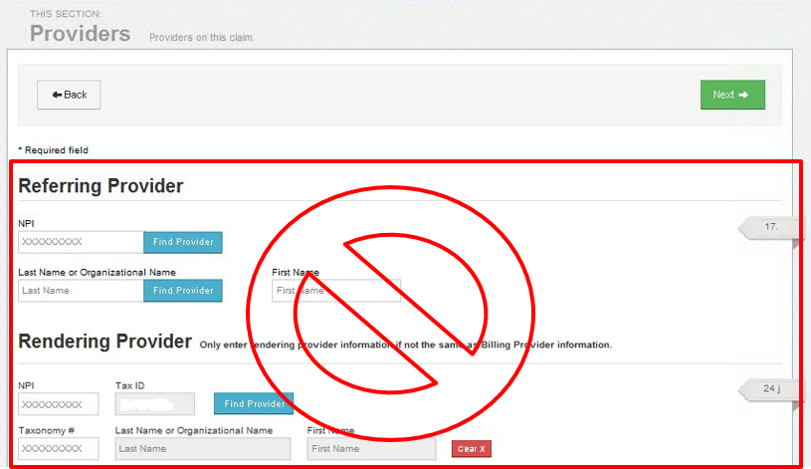
Providers
DO NOT enter information in this section.

Slide 14
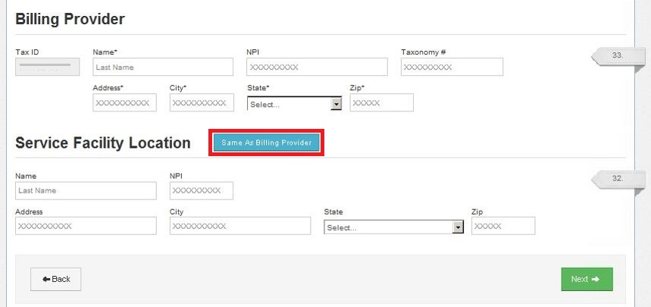
Providers (Cont’d)
STEP 17: Enter Billing Provider Name, Address, City, State, Zip.
STEP 18: Enter Service Facility Location* Name, Address, City, State, Zip.
Click Next.
* Click “Same as Billing Provider” button if Service Facility Location and Billing Provider address are the same (i.e. Assisted Living).

Slide 15
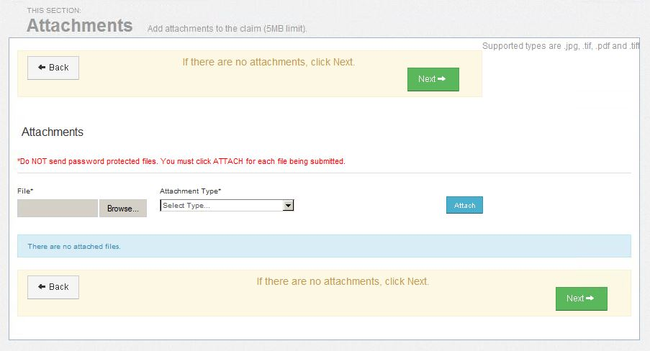
Attachments
STEP 19: Upload any Attachments where applicable.
If there are no attachments, Click Next.

Slide 16
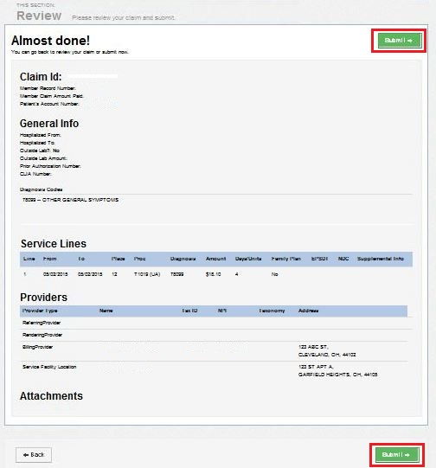
Review
STEP 20: Review your Claim.
If there are no Edits, Click Submit*.
* IMPORTANT: Carefully check the information entered for accuracy BEFORE clicking Submit.

Slide 17
Contact Us!
( Provider Services: 866.296.8731
      First point of contact for any issues.
      If you are unsure of who your Provider Network representative, contact Provider Services.
8 Website: www.buckeyehealthplan.com
      Sign in to the Secure Portal for secure messaging and we will reach back out to you.

